Slide 1
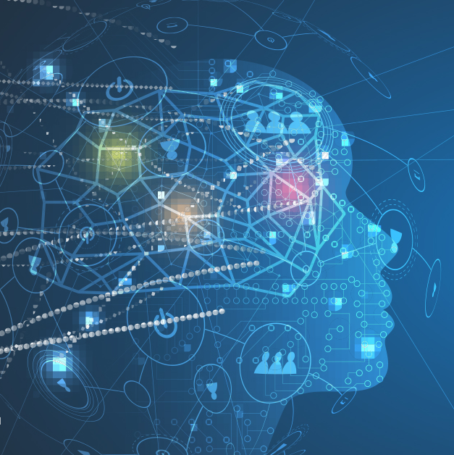

Internet of Things
This Photo by Unknown author is licensed under CC BY-ND.

Slide 2
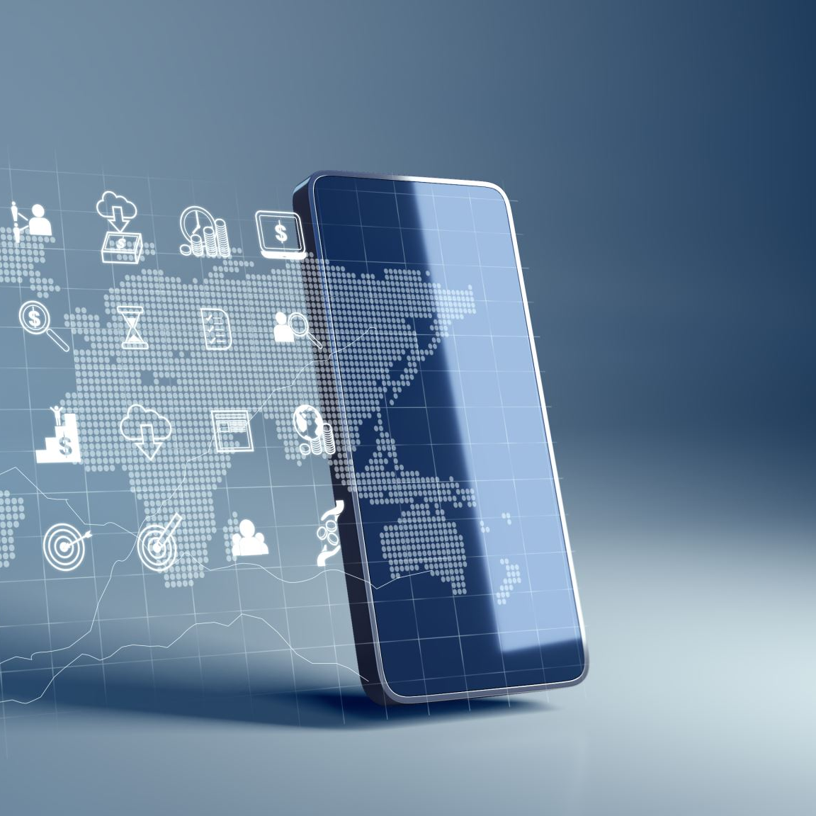
Agenda
Introduction
History
IOT Timeline
Application of IOT
How IOT Works
Senser Technologies
Challenge of IOT
Future of IOT
Conclusion
Video

Slide 3
Introduction
The Internet of Things (IOT) is the network physical objects or things.
It allows objects to be sensed and controlled remotely across existing network infrastructure.
Also called The Internet of Objects and IOT
It allows communication between human and things
Implemented by embedding sensors in different objects that can transmit and receive data.

Slide 4
History
The first IOT device to be said was a coke machine in Carnegie Mellon University, Qatar
The programmers were able to check if the machine was operating and even check the stock of the machine remaining
LG announced its first Internet Refrigerator plans in 2000

Slide 5
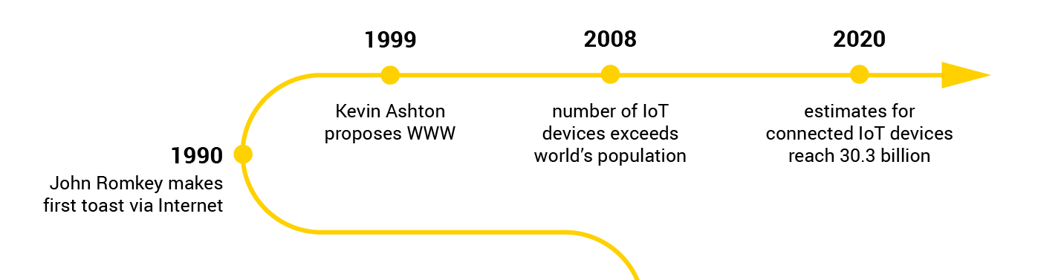
Timeline

Slide 6
How IOT Works
Various wireless radios services allow devices to connect to the Internet and to each other
Device can be connected through Wi-Fi, low-energy Bluetooth, NFC, ZigBee and Z-Wave technologies
Cloud services then enable the collection of analysis from different devices, so that the people can see what's going on and can act via their mobile apps.

Slide 7
Technology Behind IOT
Wireless sensor technology play a pivotal role in bridging the gap between the physical and virtual worlds
They enable things to respond to changes in their physical environment
Sensors collect data from their environment, generating information and raising awareness about context
Example: sensors in an electronic jacket can collect information about changes in external temperature and the parameters of the jacket can be adjusted accordingly

Slide 8
Application of IOT
Smart Cities
Smart Manufacturing
Building and Home Automation
Health Care
Automotive
Wearables

Slide 9
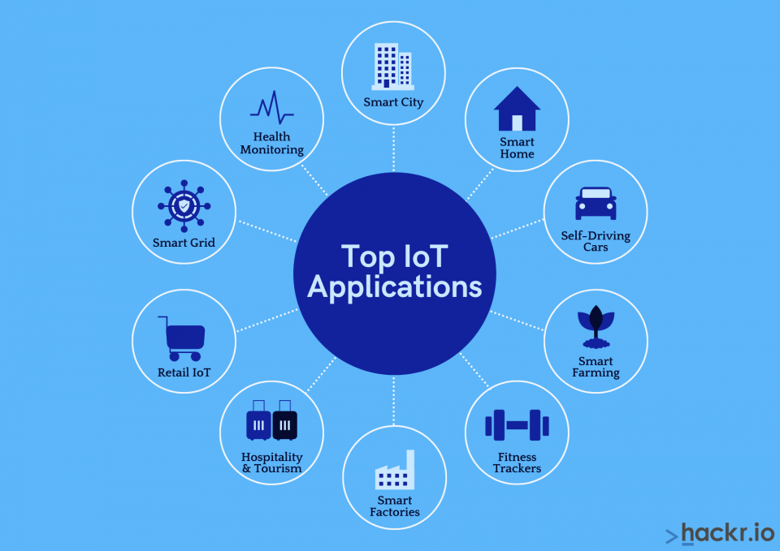

Slide 10
Conclusion
Internet of Things is closer to being implemented than the average person would think
Most of the necessary technological advances needed for it have already been made
The main reasons why it has not truly been implemented is the impact it will have on the legal, ethical, security and social fields
The internet of things can be scary or threatening to some people- too close to an automated, robotic world
Hackers could potentially access it, corporations may not want to share their data, and individual people may not like the complete absence of privacy

Slide 11


